Slide 1
Behavioral Health Information Technologies and Standards (BHITS) II
Omnibus Care Plan
Care Coordinator User Guide
Developed by FEI Systems for SAMHSA BHITS August 2018

Slide 2
Contents
Introduction
Part 1: The To Do Panel
Part 2: The Upcoming Appointments Panel
Part 3: Upcoming Tasks Panel
Part 4: The Calendar Panel
Part 6: Managing the Patient’s Detail Page
6.1: Managing the Patient’s Task Panel
6.2: Managing the Patient’s Care Teams Panel
6.3: Manage Patient’s To Do Panel
6.4: Manage Patient’s Appointments
6.5 Manage Patient’s Communications
6.6 Manage Patient’s Coverage
Part 7: Viewing and Creating Consents

Slide 3

Omnibus Care Premise
Patient-centered care revolves around effective and efficient care coordination across care providers, patient engagement, social connectedness, and facilitating the patients’ treatment beyond episodic or chronic treatment.
Today, the healthcare environment is fragmented and ineffectual in providing 360⁰ whole-patient care with the mix of private and public insurers and self-pay with a large number of no-pay patients.
SAMHSA is devoted to the care and treatment of behavioral health patients. New models of paying for care are being developed and initiated with the objective to reduce the cost of healthcare.

Slide 4
About the Omnibus Care Plan
A patient-centric, standards-based, goal-driven treatment plan
Application through which the patient and his or her care team can communicate
Authoritative source for care planning
Synthesize, reconcile, and de-conflict patients’ data
Monitor patients’ data and monitor processes across health care institution boundaries
Real-time integrated view of an individual care plan
Includes structured and narrative information

Slide 5
Omnibus Care Plan Modules
Organization Administration Module–Adding and managing organization details, contact personnel, locations and activity definitions
Practitioners Module–Adding and managing practitioner details, practitioner roles and organization association
Patients Module–Adding and managing patient details, patient’s care teams (which include members across organizations, related persons and other patients) and patient’s insurance/benefits details
OCP Access Module–Register users to OCP and manage user access
Appointments and Scheduling Module–Creating appointments, appointment actions (accept, tentative, decline), calendar view, appointments panel and importing organization Outlook calendar into OCP
Tasks and To-Do Module–Creating, managing and updating patient-related tasks (based on organization defined activity definitions) and patient related To-Dos
Communications Module–Logging patient communications and associate communications with appointments, tasks and To-Dos
Care Planning Module–Creating and managing care plan in Quippe Clinical Lens
Screeners and Assessment Module–Patient screeners and assessments through bhworks CUBS assessment tool
Consent Management Module–Creating and managing patient’s consents through Consent2Share
SMART-on-FHIR Apps Management Module–Consent2Share, Quippe Clinical Lens & Designer, bhworks CUBS Assessment

Slide 6


Omnibus Care Plan Functional Overview
Administrative
Program, Services, Locations
Patient Enrollment
Practitioners, Organizations
Episode of Care
Care Coordination
Caseload Mgmt. Dashboard
Program Mgmt.
Screener/ Assessment
Scored screening and assessments (MA Assessment, PHQ9, PHQ4, etc.)
BH-Works Comprehensive Assessment
Care Planning
SOAP/Visit Notes
Outreach/ Activity Management
Smart Notes
Dynamic Care Plan Summary
Scheduling/ Appointment
New Appointments
Encounter Management
Goals and Interventions based on Outcomes/scores
Patient Consent
Computable Scores/sub-scores (LOINC)
Enrollee/ Consumer Dashboard
Standards-based Data Shared Among Applications
5

Slide 7
Omnibus Care Plan Portal and Users
OCP Admin
Onboarding of organizations to OCP and adding practitioners to OCP
Managing roles/users in UAA and Helpdesk/Troubleshooting
Org Admin
Managing organization locations, healthcare services, activity definitions
Associating practitioners to organization/location and assigning roles
Care Manager
Manage patient information, care teams, and assign care coordinators
Patient consents
Care Coordinator
Tasks, To Do, Appointments, Communication, Assessments
Care Coordination activities and care plan management
Patient
Other Possible Functional Roles
Similar Care coordination activities for Benefits specialist, Front Office, Health Assistant, and so on
Patient information, Care Team
Business Function Role
Capabilities to be Demonstrated
Appointments, Communication, Consents

Slide 8
About the Omnibus Care Plan User Guides
The Omnibus Care Plan User Guides will provide information about how different users navigate the Omnibus Care Plan, and more:
Omnibus Care Plan Admin User Guide
Organization Admin User Guide
Care Manager User Guide
Care Coordinator User Guide
Other Roles
SMART on FHIR Applications

Slide 9
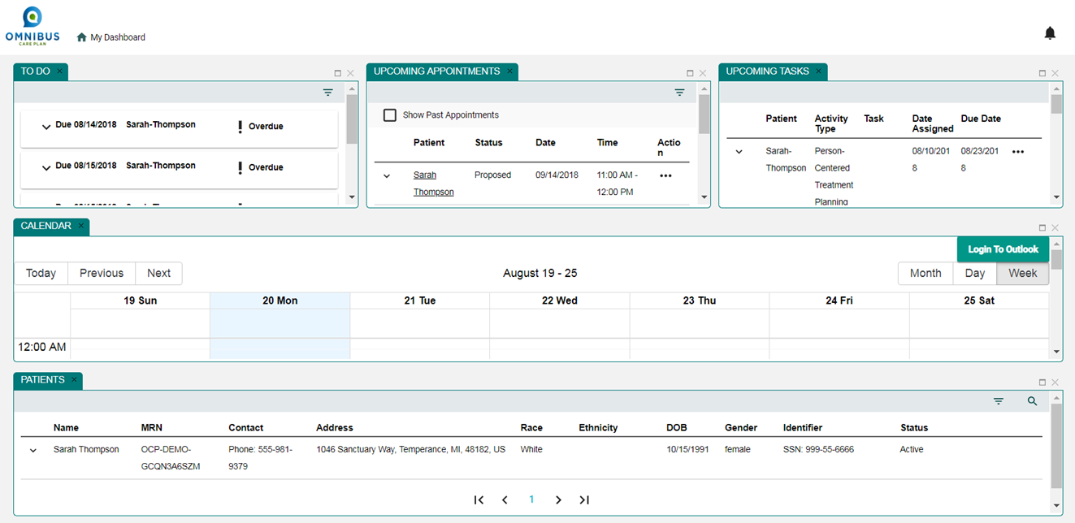
Role of the OCP Care Coordinator
View and create patient’s “To Dos”
View and create patient’s appointments
View and create patient’s tasks
View all accepted appointments in patient’s calendar
View all patients in the program
Create and view patient’s care team
View patient’s communications
View patient’s coverage
View patient’s consents

Slide 10
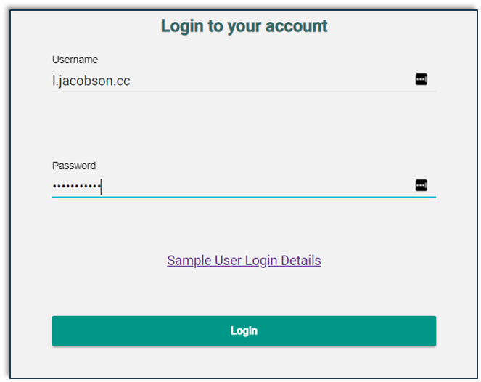
OCP Care Coordinator Login Page
Login using Care Coordinator credentials

Slide 11
The OCP Care Coordinator Dashboard
The Care Manager Dashboard has five panels:
To Do
Upcoming Appointments
Upcoming Tasks
Calendar
Patients

Slide 12
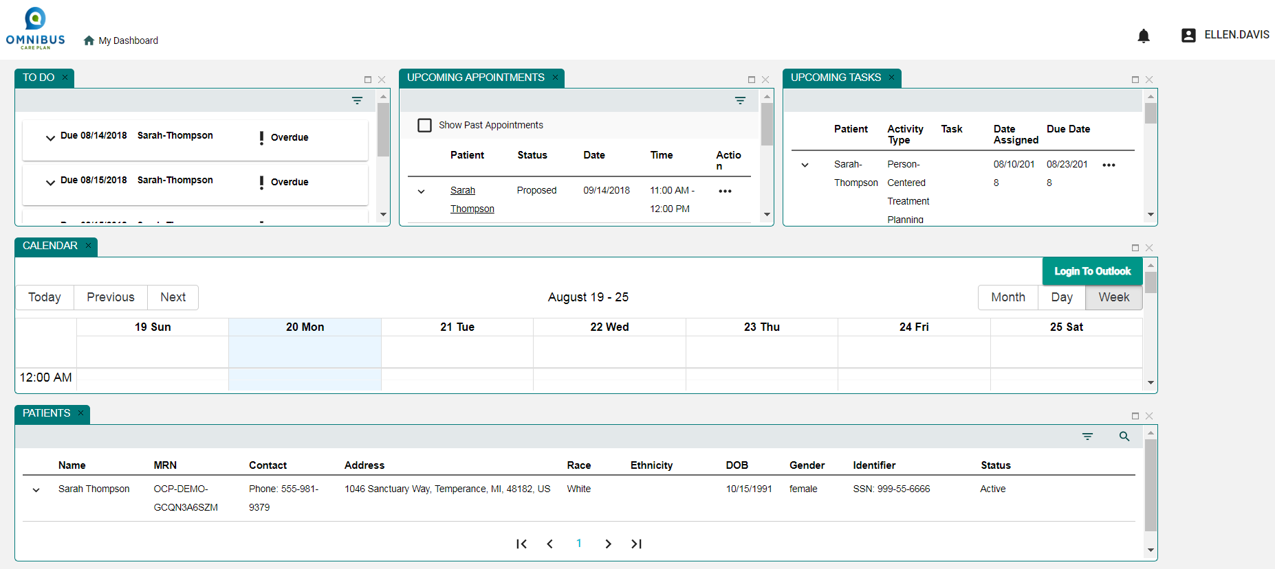
OCP Care Coordinator Dashboard

Slide 13
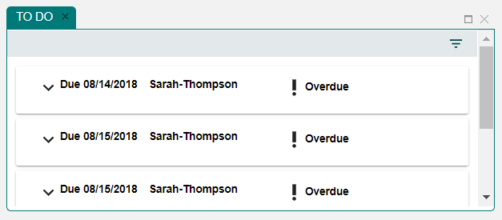
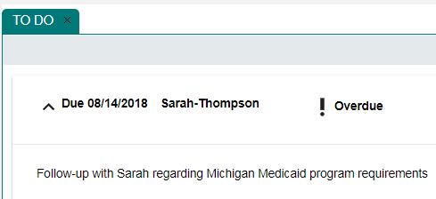
Part 1: The To Do Panel
Click chevron to view To Do details.

Slide 14
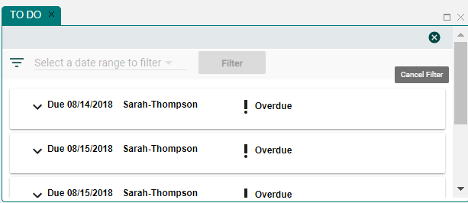
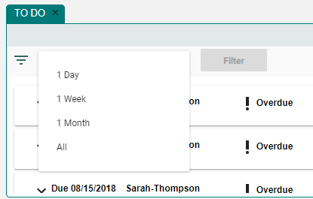
The To Do Panel Search Filter
Click Filter icon.
Select date range to filter.
Provides options from 1 day to All.

Slide 15
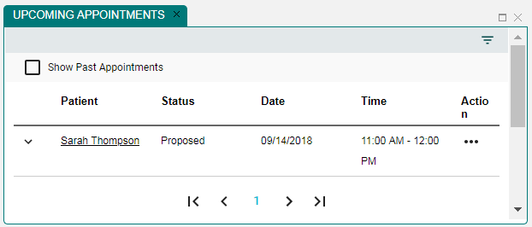
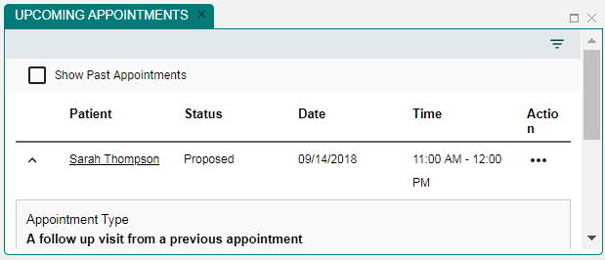
Part 2: The Upcoming Appointments Panel
Click chevron to view Appointment details.

Slide 16
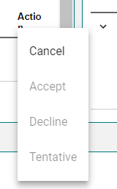
Upcoming Appointments Panel
Click chevron to cancel appointment.

Slide 17
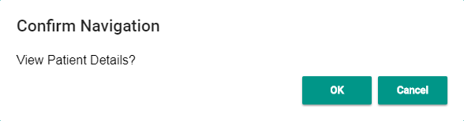
Upcoming Appointments Panel: View Patient Details
Click link to view patient details.
Select Yes button to view patient details.

Slide 18
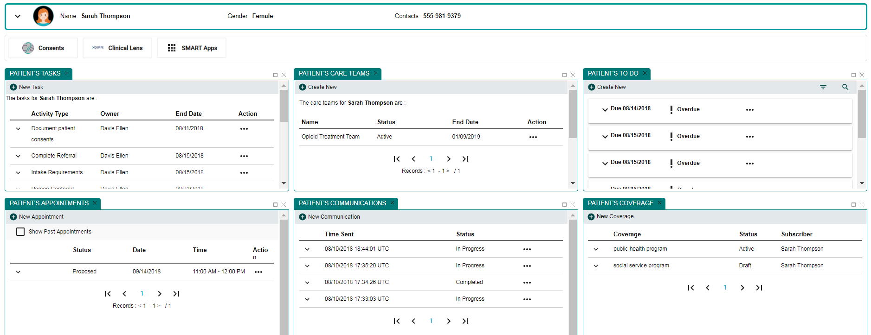
Patient’s Details Page
Clicking Yes opens the Patient’s Details Page.

Slide 19
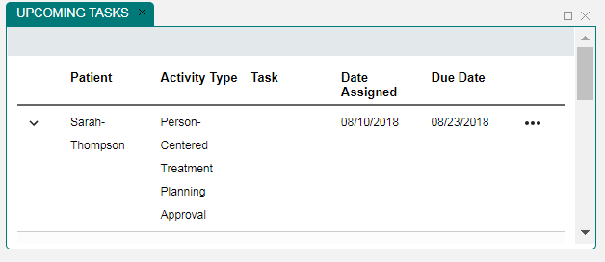

Part 3: Upcoming Tasks Panel: View Details
Click ellipses to see details.

Slide 20
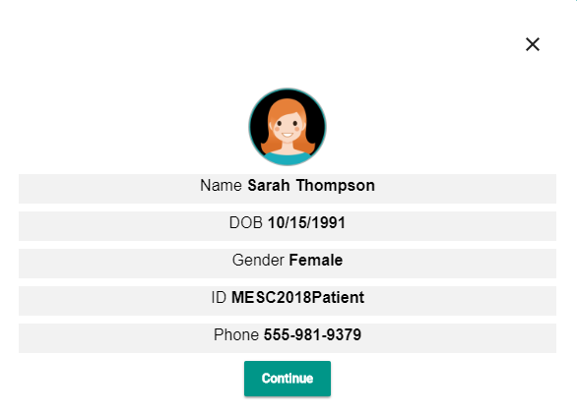
Patient Card Opens
Click Continue button to view details.

Slide 21
Patient’s Details Page
Clicking Continue button opens the Patient’s Details Page.

Slide 22
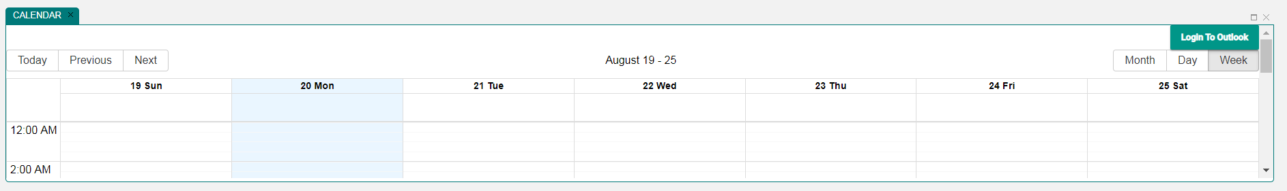
Part 4: The Calendar Panel
OCP Care Coordinator can view patient’s calendar
Clicking Expand square will expand the calendar

Slide 23
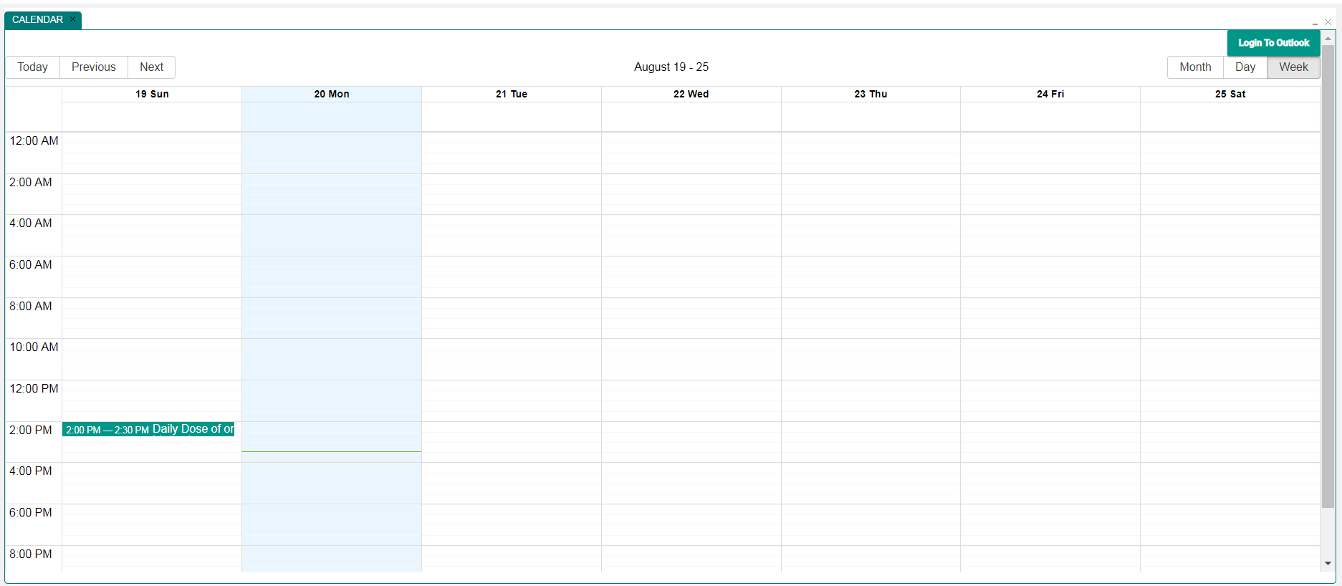
Calendar Panel Expanded
Expanded view of patient’s calendar

Slide 24
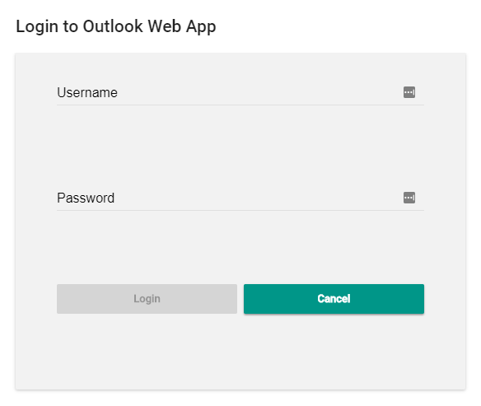
Calendar Panel: Login to Outlook
OCP calendar can be linked to Outlook.
Select Login to Outlook.
Enter Outlook Username and Password

Slide 25
Calendar Panel: Login to Outlook
OCP calendar can be linked to Outlook.
Select Login to Outlook.

Slide 26
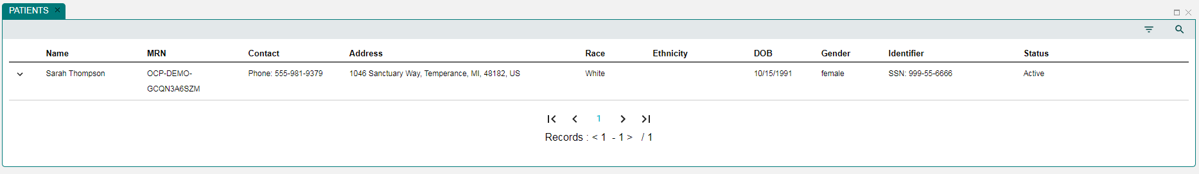
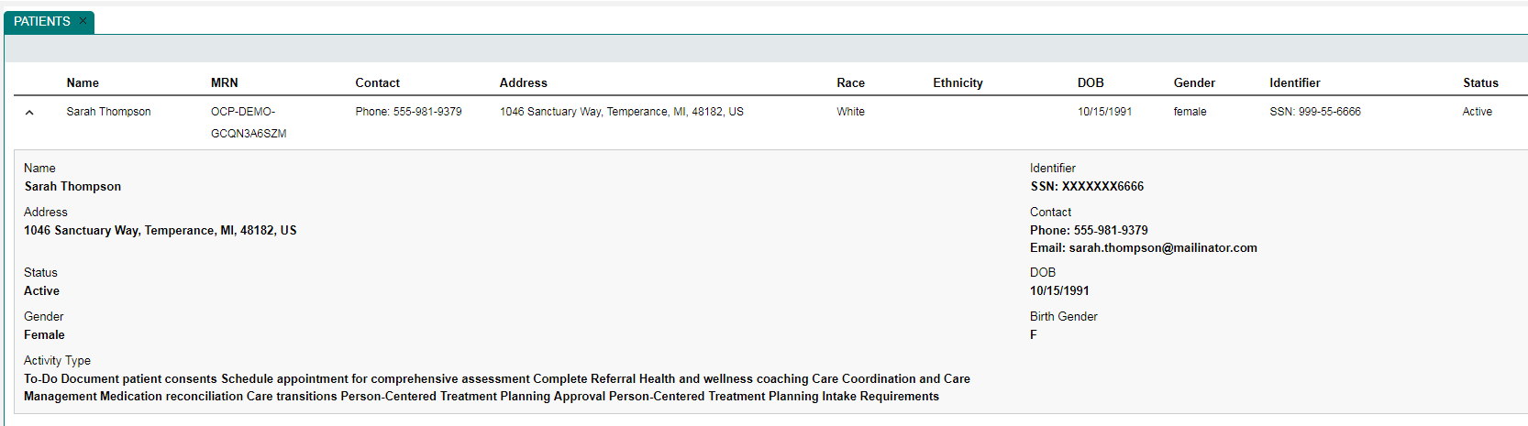
Part 5: The Patients Panel
Click chevron for patient details.

Slide 27
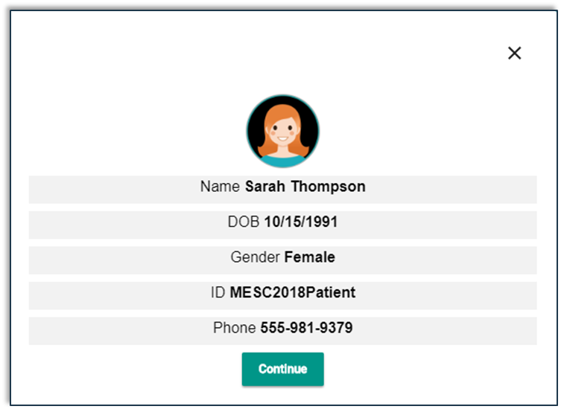
The Patients Panel
Click name for chevron for Patient Details Page.
Patient Card opens.

Slide 28
Patient’s Details Page
Clicking Continue button opens the Patient’s Details Page.

Slide 29
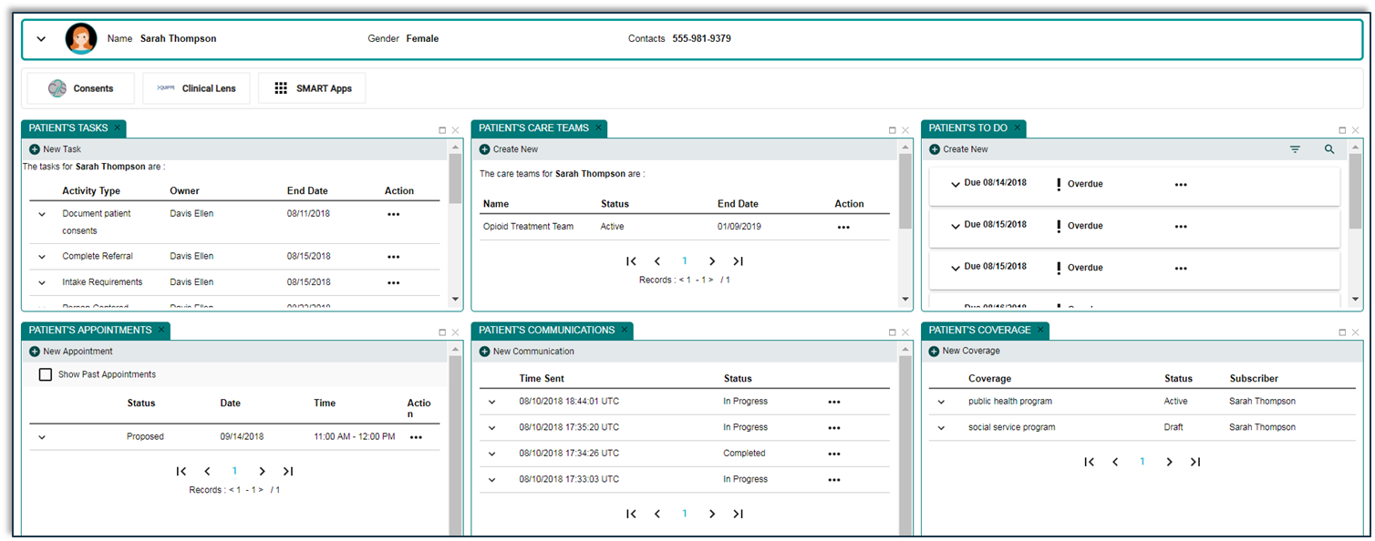
Part 6: Managing the Patient’s Details Page
Panels: Patient’s Tasks, Patient’s Care Teams, Patient’s To Do, Patient’s Appointments, Patient’s Communications, and Patient’s Coverage

Slide 30
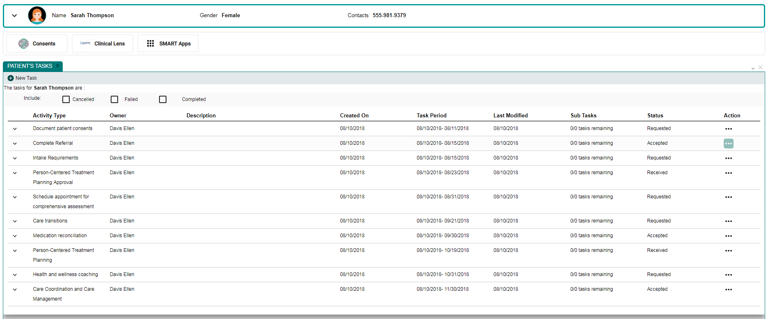
6.1: Managing the Patient’s Tasks Panel

Slide 31
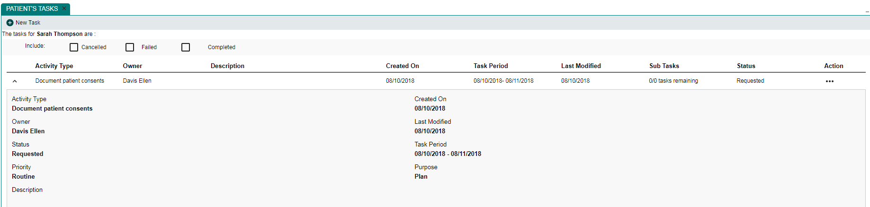
Patient’s Tasks: Expand Patient Tasks Details
Clicking chevron opens Patients Tasks details.

Slide 32
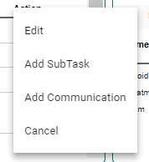
Patient’s Tasks: Edit, Cancel, etc. Options
Click Action ellipses to open options.
1
2

Slide 33
Patient’s Tasks: Edit
After clicking Action ellipses, click Edit option

Slide 34
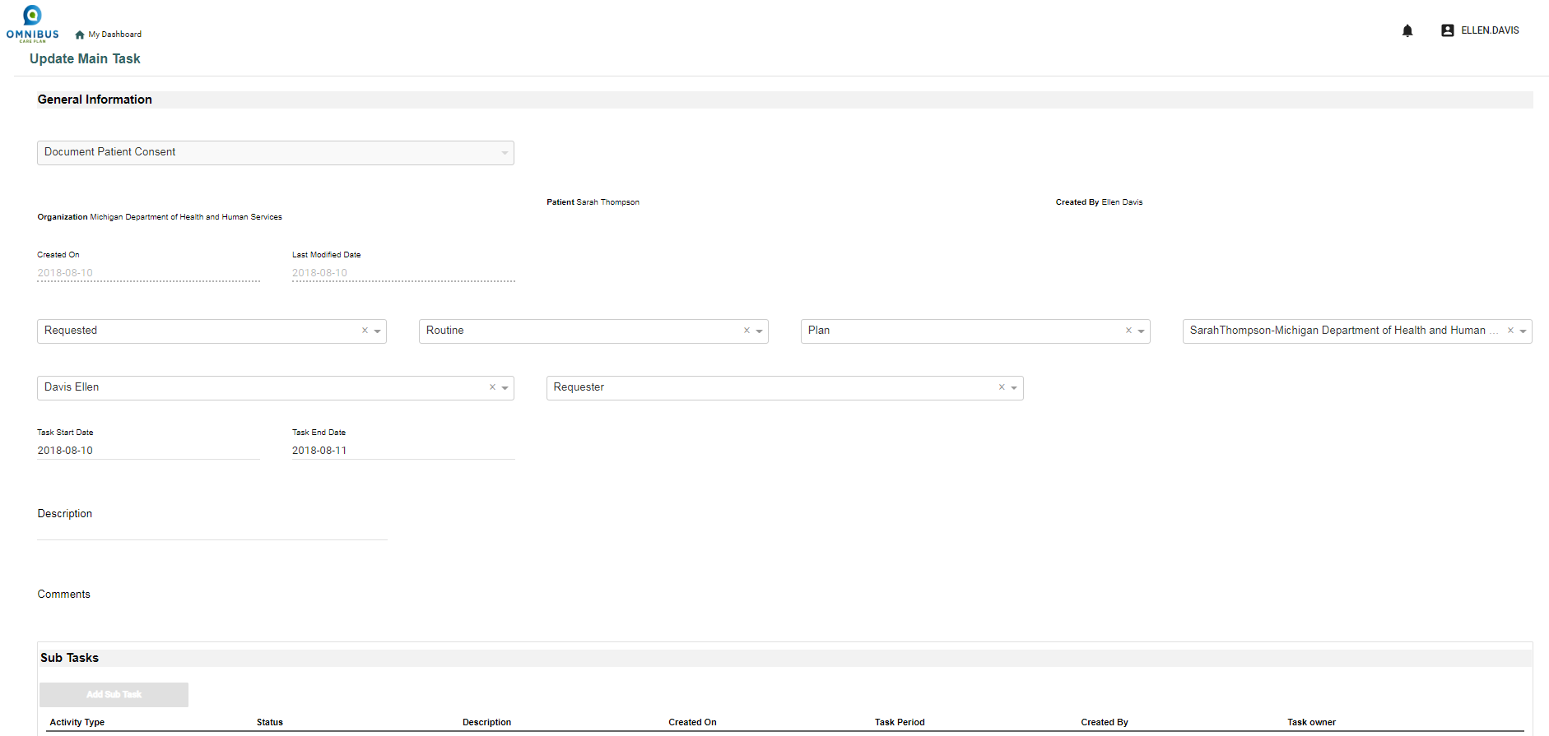
Patient’s Tasks: Update Main Task Page Opens

Slide 35
Patient’s Tasks: Add SubTask
After clicking Action ellipses, click Add SubTask option option

Slide 36
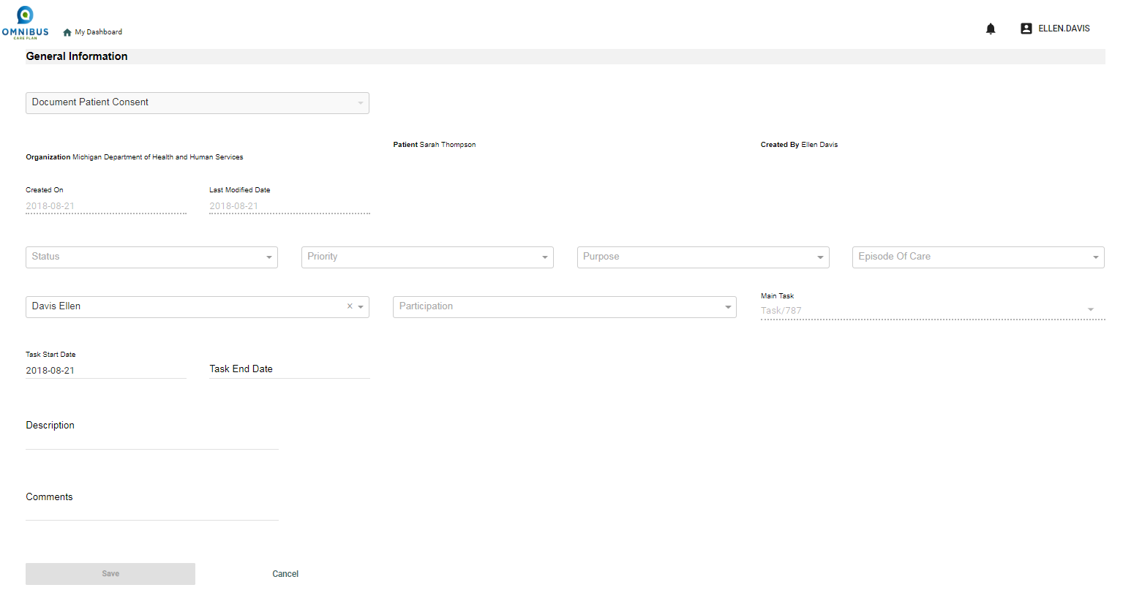
Patient’s Tasks: Add SubTask Page Opens
After clicking Action ellipses, click Add SubTask option option

Slide 37
Patient’s Tasks: Add Communication
After clicking Action ellipses, click Add Communication option

Slide 38
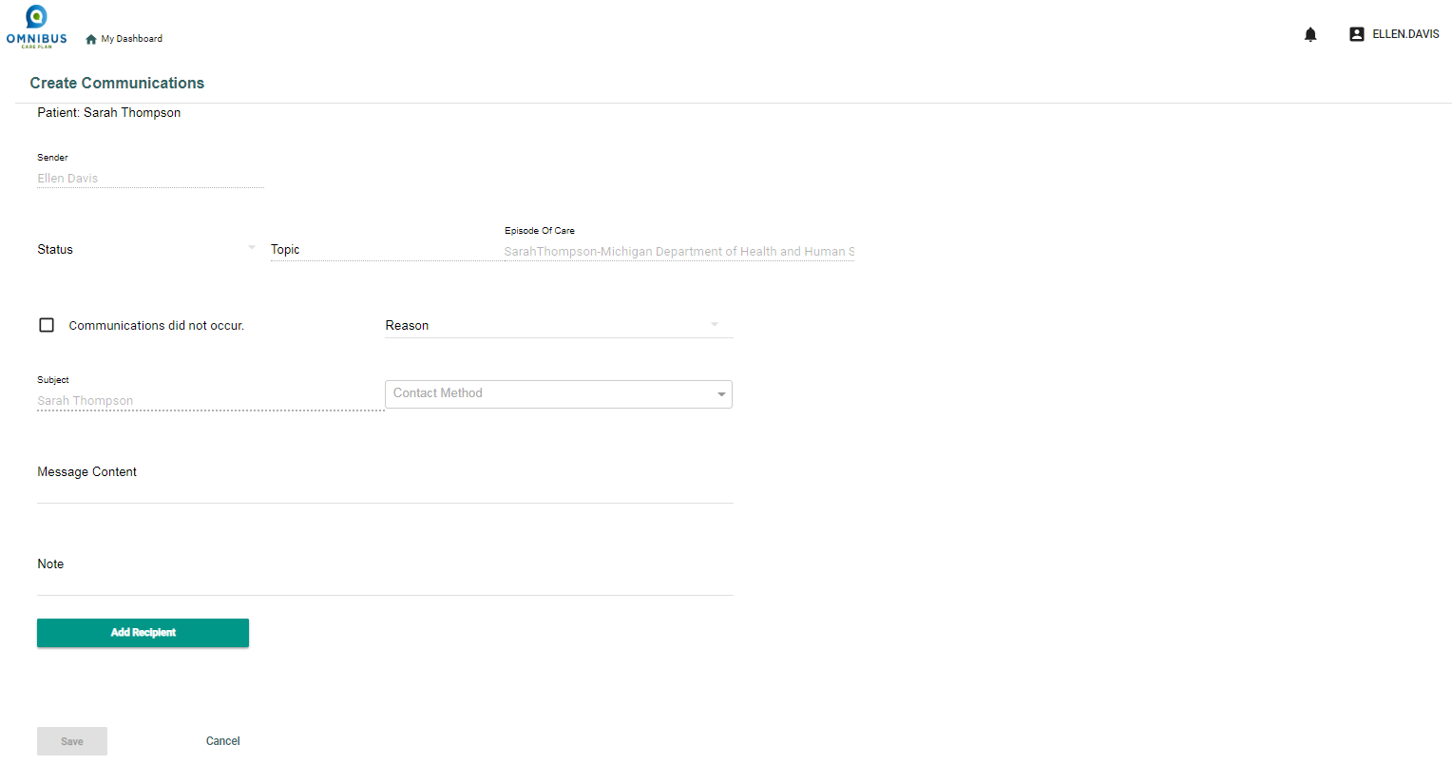
Patient’s Tasks: Add Communication Page Opens

Slide 39
Patient’s Tasks: Cancel
After clicking Action ellipses, click Cancel option

Slide 40
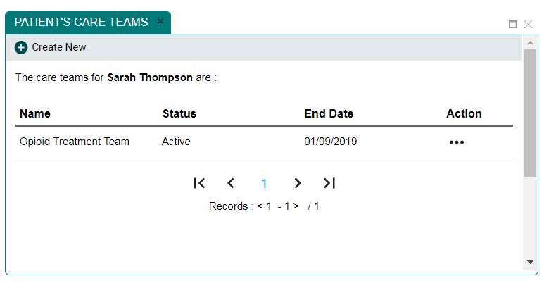
6.2: Managing Patient’s Care Teams Panel

Slide 41
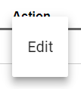
Patient’s Care Teams: Edit Care Team
To edit existing Care Team, click Action ellipses

Slide 42
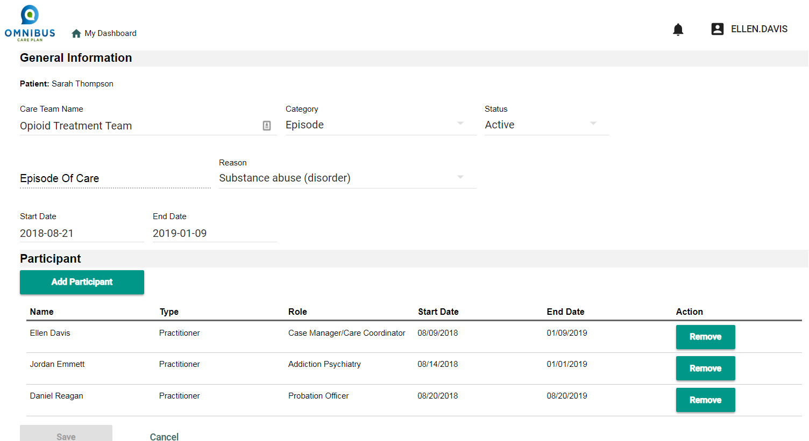
Patient’s Care Teams: Edit Care Team Page Opens

Slide 43
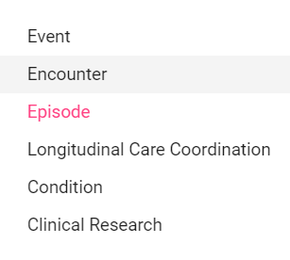
Patient’s Care Teams: Edit Category

Slide 44
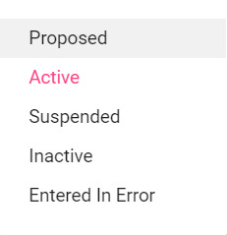
Patient’s Care Teams: Edit Status

Slide 45
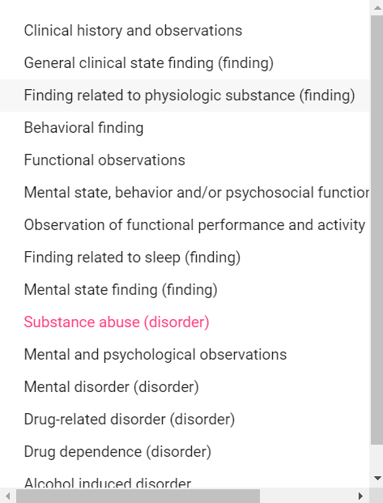
Patient’s Care Teams: Edit Reason

Slide 46
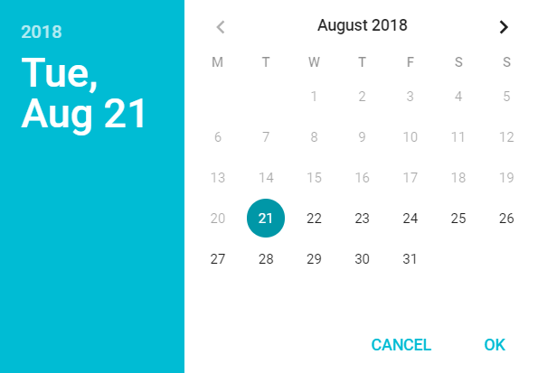
Patient’s Care Teams: Edit Start/Stop Dates

Slide 47
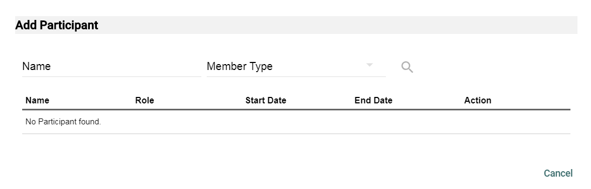
Patient’s Care Teams: Add Participant

Slide 48
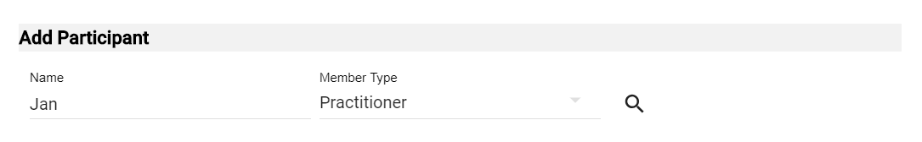
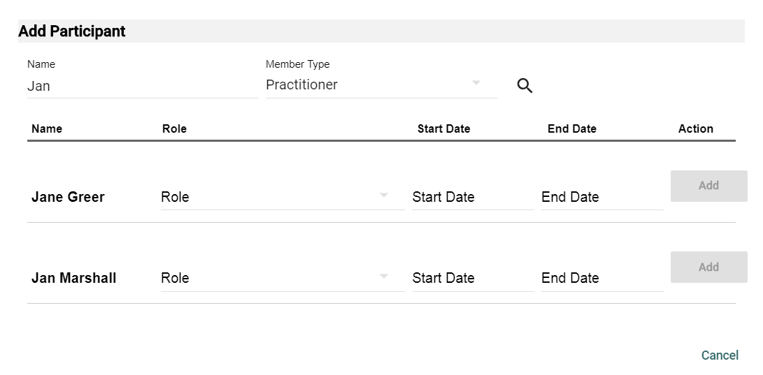
Patient’s Care Teams: Search for Participant
Enter first three letters of name, select member type, click search, results appear.

Slide 49
Patient’s Care Teams: Search for Participant
Select Role, Start and End Dates, click Add button.

Slide 50
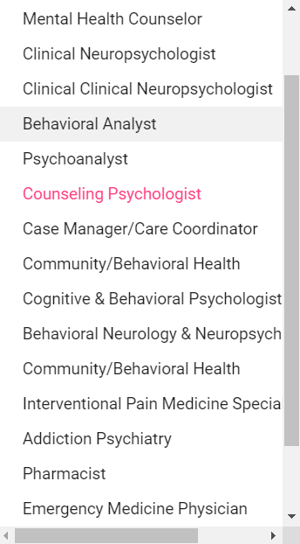
Patient’s Care Teams: Select Role
Select Role

Slide 51
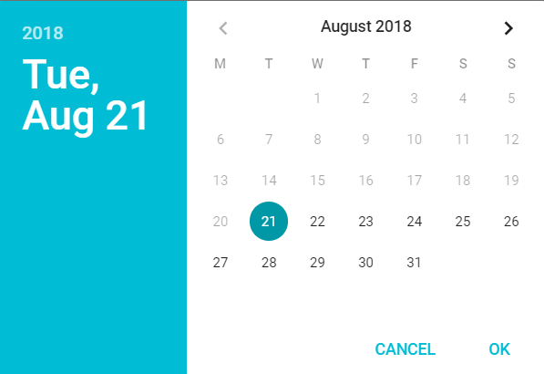
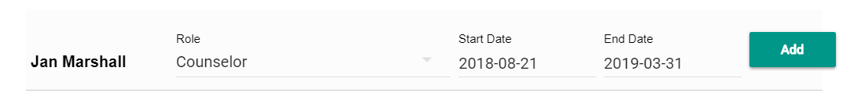
Patient’s Care Teams: Select Dates
Select Role, Start and End Dates, click OK, and click Add button.

Slide 52
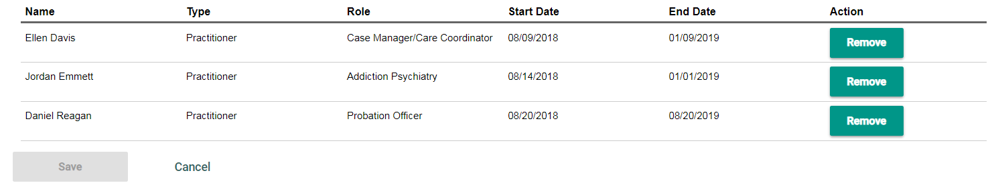
Patient’s Care Teams: Delete Participant
To delete a participant from the Care Team, click the Remove button and save.

Slide 53
Create New Care Team
To create new Care Team, click Create New icon.

Slide 54
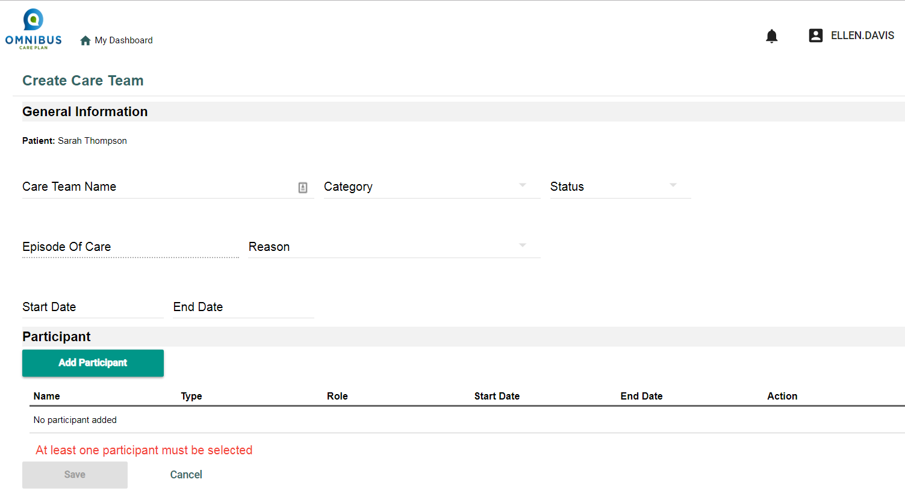
Create Care Team Page Opens
Add required information and select Add Participant button.

Slide 55
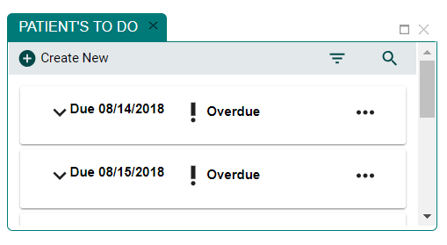
6.3: Manage Patient’s To Do Panel
The care Coordinator can view, edit, and create the Patient’s To Do list.

Slide 56
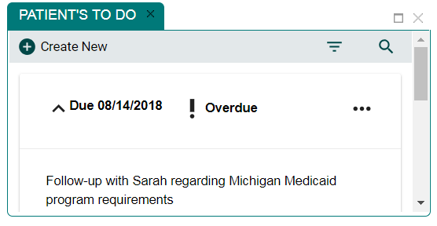
To Do: View To Do Details
Click chevron to view item details.

Slide 57
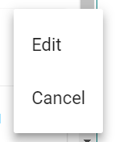
To Do: Edit or Cancel
Click chevron to view item details.

Slide 58
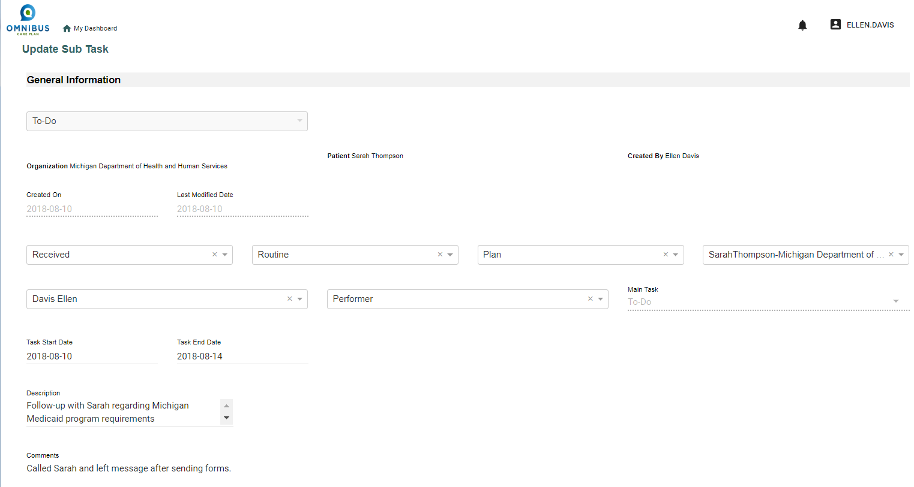
To Do: Update Sub Task

Slide 59
To Do: Update Sub Task
Can update fields for:
Status: Draft, Requested, Received, Accepted, Rejected
Priority: Routine, Urgent, ASAP, STAT
Purpose: Proposal, Plan, Order, Original Order, Reflex Order
Episode of Care
Task Owner
Participation: Acquirer, Dispatcher, Manager, Monitor, Performer
Task Start Date
Task End Date
Description
Comments

Slide 60
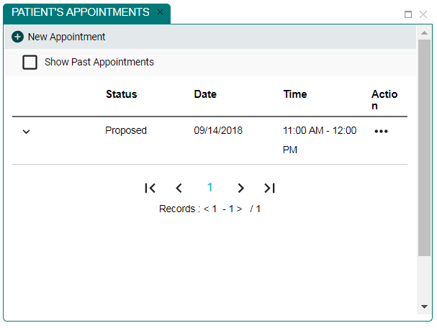
6.4: Manage Patient’s Appointments
The Care Coordinator can view and manage patient’s appointments.

Slide 61
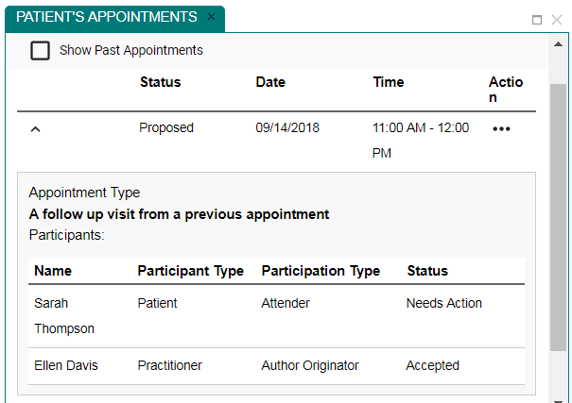
Manage Appointments: View Details
Click chevron to view appointment details.

Slide 62
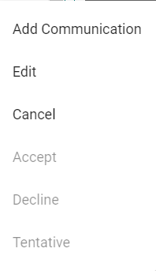
Manage Appointments: Modify
Click Action ellipses to Add Communication, Edit, or Cancel

Slide 63
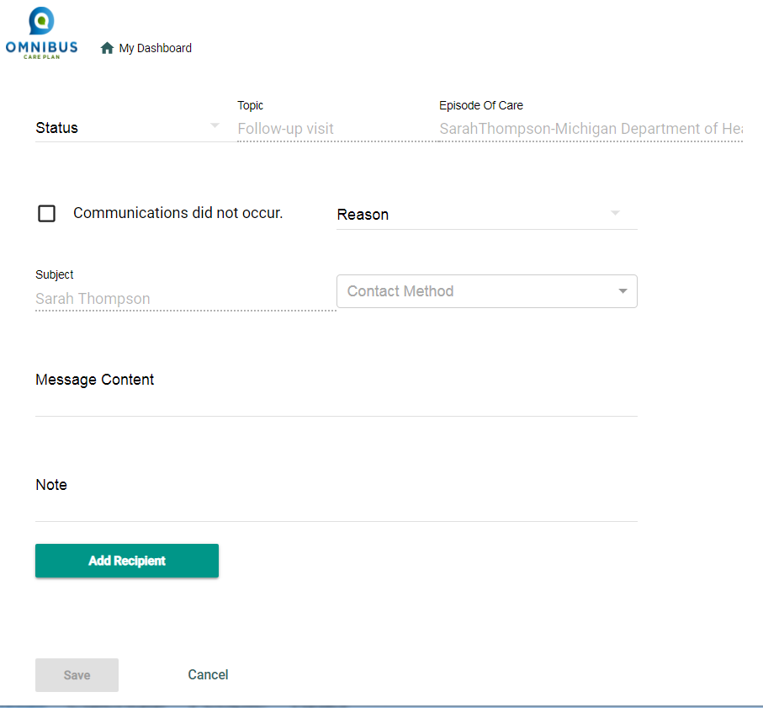
Manage Appointments: Add Communication
Click Add Communication

Slide 64


Manage Appointments: Complete Status
Can choose Reason and Contact Method
Can create message
Can write note

Slide 65


Manage Appointments: Edit Status
Click Status

Slide 66

Manage Appointments: Edit Status
Click Add Participant and Add Participant option opens.
Complete required fields

Slide 67

Manage Appointments: Cancel Appointment
Click Cancel and appointment is canceled. Status changes to Canceled.

Slide 68

6.5: Manage Patient’s Communications
Care Coordinator can manage patient’s communications.

Slide 69

Manage Patient’s Communications: Review
Click chevron to review a communication.

Slide 70

Manage Patient’s Communications: Edit
Click ellipses to edit chevron to review a communication.

Slide 71




Manage Patient’s Communications: Edit Options
X
Options for Status and Reason.

Slide 72

Manage Patient’s Communications: Add Recipient
Enter new recipient name
Enter Member Type and required fields
Click the Add button

Slide 73

6.6: Manage Patient’s Coverage
Care Coordinators can manage patient’s coverage

Slide 74

Manage Patient’s Coverage: View Details
Click chevron to view details

Slide 75
Manage Patient’s Coverage: View Details
Click chevron to view details

Slide 76


Manage Patient’s Coverage: Add New Coverage
Click New Coverage icon

Slide 77

Manage Patient’s Coverage: Add New Coverage
Enter required information and click the Save button.

Slide 78



Manage Patient’s Coverage: Edit Options
Required information for Relationship, Coverage Type, and Status.

Slide 79


Part 7: Viewing and Creating Consents
Care Coordinators can View and Create Patient Consents
First click patient name. Patient Card opens. Click Continue Button.

Slide 80


Consents: Viewing Consents
Click Consents, Patient Consents Page opens

Slide 81
Consents: View Consents
STAN: Would be nice to have a grab of existing consents here

Slide 82
Consents: Add New Consent
Click Add New Consent button

Slide 83

Consents: Patient Consent Page Opens

Slide 84
Consents: Creating Consent for Patient
Select Care Teams
Select Medical Information
Select Purpose of Use
Select Consent Terms

Slide 85

Consents: Edit Disclose Information To
Click And Disclose My Information To Button.

Slide 86


Consents: Select “To” Actors
Click Disclose My Information To Button
Select “To” Actors page opens
Select Organizations and Practitioners
Click Confirm Button

Slide 87

Consents: “To” and “From” Actors Populate

Slide 88
Consents: Edit Purpose of Use

Slide 89


Consents: Edit Purpose of Use
Click Edit Button
Sharing options pop-up opens.

Slide 90



Consents: Edit Dates
Select Consent Start Date
Select Consent End Date
Calendars open

Slide 91

Consents: Select Make Available to Entire Care Team
There is an option to share health data with the patient’s entire Care Team

Slide 92

Consents: Select Make Available to Entire Care Team
One selected, the page opens like this

